Slide 1
ReactJS Learning Program
Final Project Presentation
by Jim John
on 22-Aug-2020
Notes:
Hi Everyone,
Good Morning
Before we start with the presentation today, I would like to share a small recital.
We have been a part of Publicis Sapient for almost 3months now, and there is this fact that everyone of us would agree upon.
We all started as fresh graduates, underwent 5weeks or so of rigorous training followed by what…5 weeks now of a Hands On project, and what has transpired in these days is a fact that we all are really proud of. A transformation from someone who could code, to someone who can not only code, but add value to everything he does.
So have we succeeded at becoming a Product engineer?
Hi, I am Rajat, a small part of our big team here.
I am here with my colleagues Aman and Chinmay and we are here to give you a walkthrough of our Transformation, our Journey and the project we have been working for sometime now.

Slide 2

Agenda
01
Our Journey
02
Project Goals
03
Tech Stack
04
Development
05
Challenges & Learnings
06
Demo
07
Questions
Notes:
Time – 1 min

Slide 3
1
The Ask – Where we started? Experienced in html ,CSS and vanilla Java script.
…..

Slide 4
Objective of the Engagement
To Learn React JS and relative skills like HTML5, CSS3, Javascript (6) and build the Claim Summary use case. Process include creating wire frames with HTML 5 and CSS 3 and convert to React JS.
Tech Stack
CSS 3 ,HTML 5
React JS
React Boot Strap
Loggin
Reducer
Axios
JSON Server
Lint
Jest

Slide 5
Training for 3 Weeks
3 weeks trainer led training

Slide 6

Our Journey
Notes:
Time - 2 mins

Slide 7
Demo
Process
5
Project Demo
4
Assignment + Review
3
Learning + Coding +Improving
2
Code Editing Tools (Visual Studio Code)
1
Understanding basic HTML/CSS/Java script (ES 5 &6)

Slide 8

Project Goals
Notes:
Time – 3 mins

Slide 9




Our Vision
Create claim listing and update application with React JS including Login Module.
Introduce Reducer concept into the project and apply for login and claim list.
1
2
Quality
Security
3
4
Interactivity
Speed
Notes:
User satisfaction and brand value

Slide 10
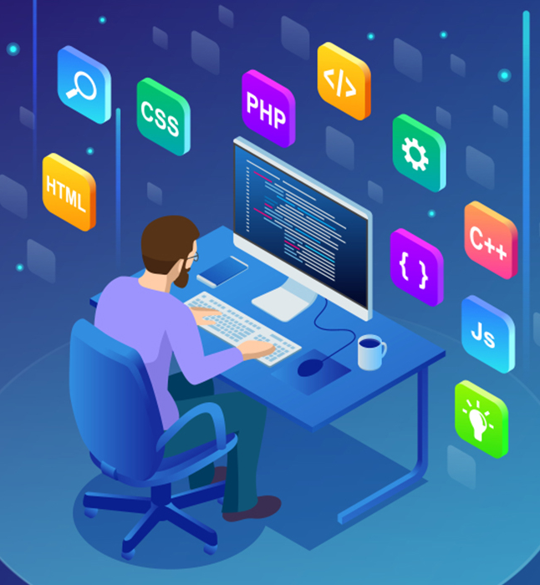
Tech Stack
Notes:
Time – 2 mins

Slide 11

Development
Notes:
Time – 1 min

Slide 12
Sprint Planning
Planned to deliver as two milestones for the project
Sprint Grooming
Requirement understanding
Sprint Implementation
Convert HTML to React components
Delivery
Present to trainer/mentor
Create HTML prototypes
Use bootstrap to make responsive
Use redux for store implementation
Notes:
Time – 1 min

Slide 13

Challenges & Learnings
Notes:
Time – 2 mins

Slide 14





Challenges & Learnings
1
2
3
4
5
Mindset
Technology
Communication
Management
Leadership
Understading ES6 and View concept and Redex was tough.
Apart from JavaScript,HTML and CSS all are new to me.
Communication with the trainer helped in effective learning
Tough time management to learn new skill and apply them in project
Did some talks to understand the technical part.
Notes:
User satisfaction and brand value

Slide 15

Demo
Notes:
Time –
Architecture – 5 mins
NFR Dashboard – 3 mins
Demo – 10 mins
1. Show the Responsiveness and Wave tool first

Slide 16

Questions
Notes:
Time - ?

Slide 17
Thank you
Notes:
Time – After this show the testimonial video. 1 min

